Slide 1
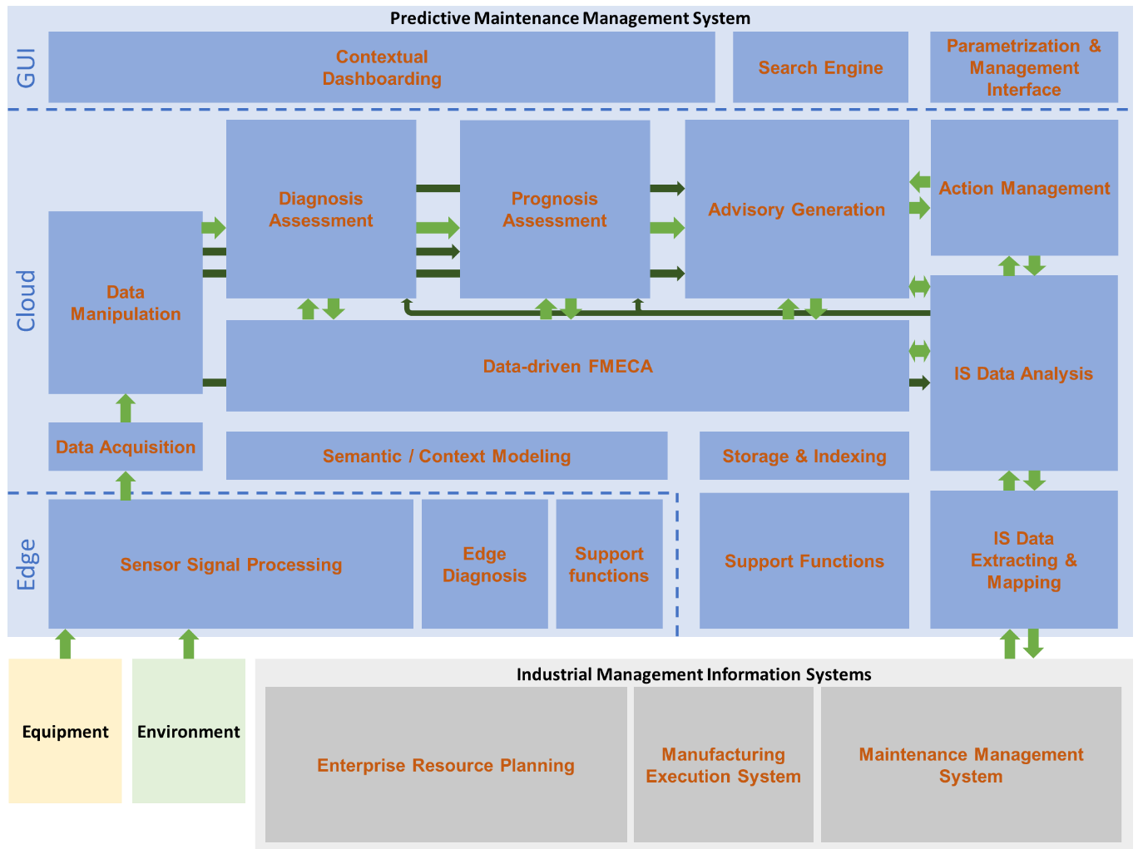
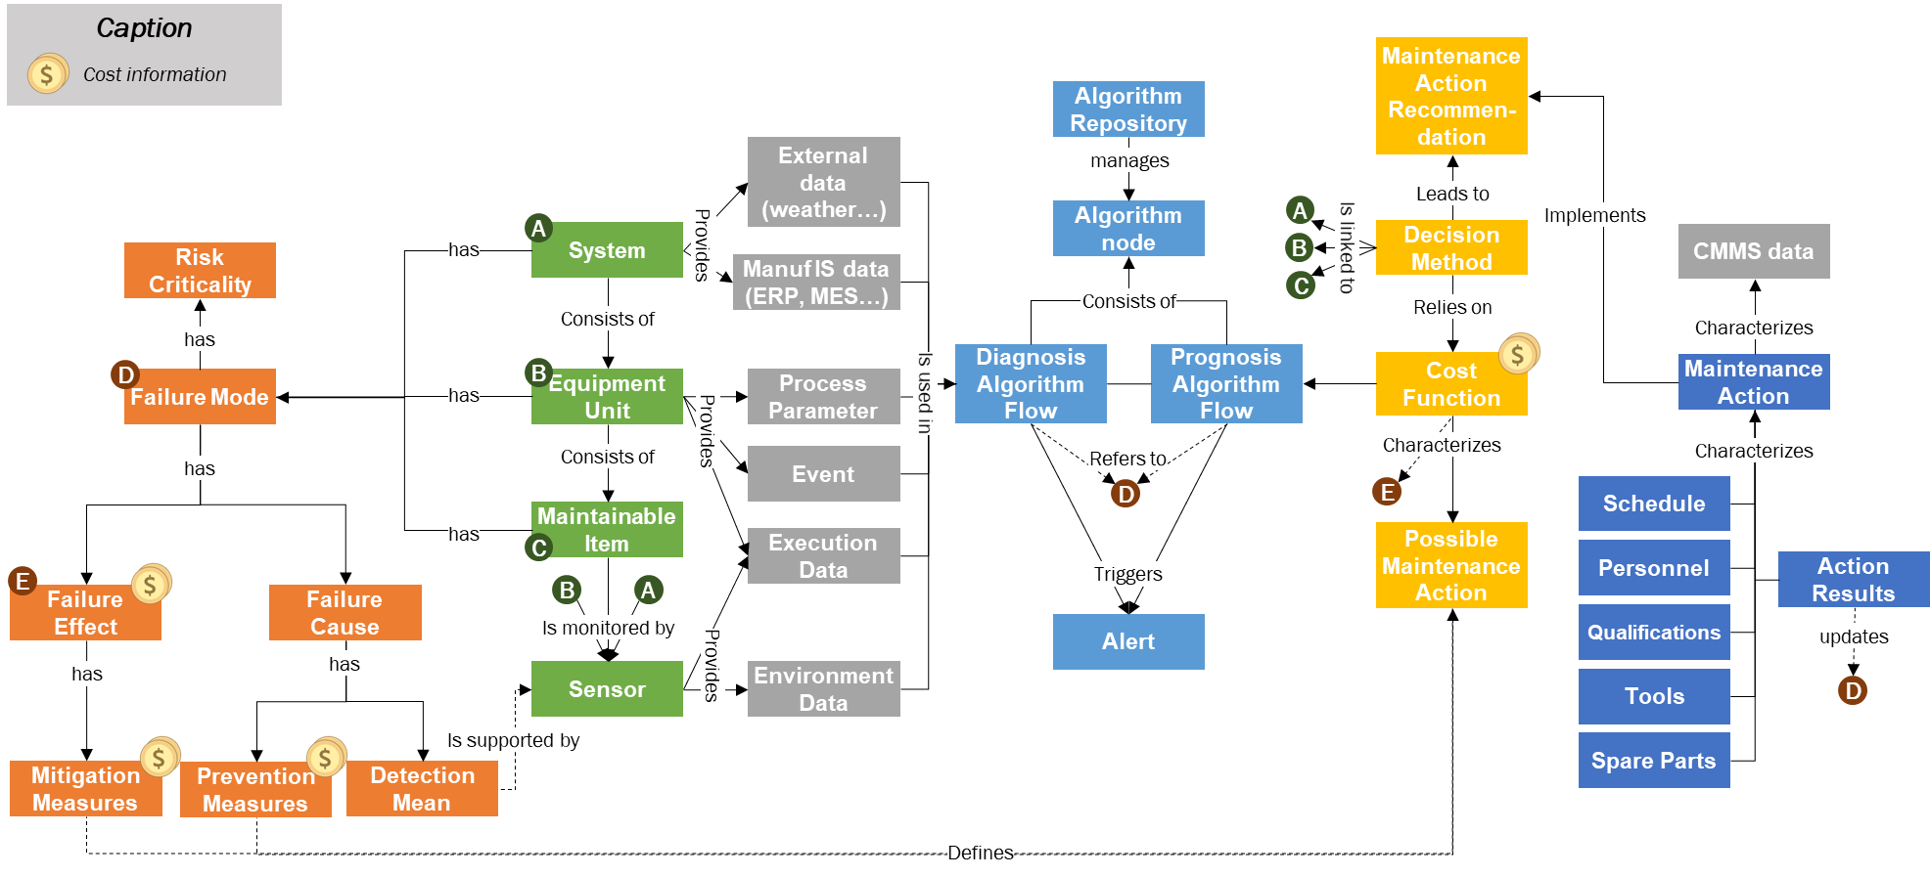
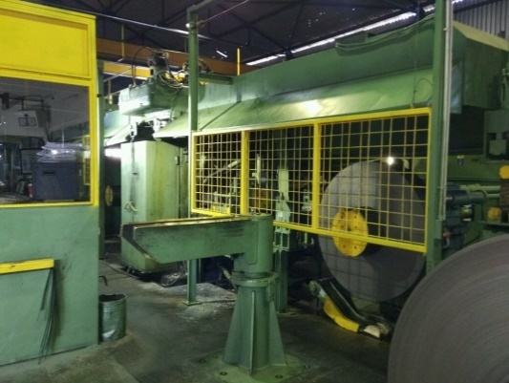
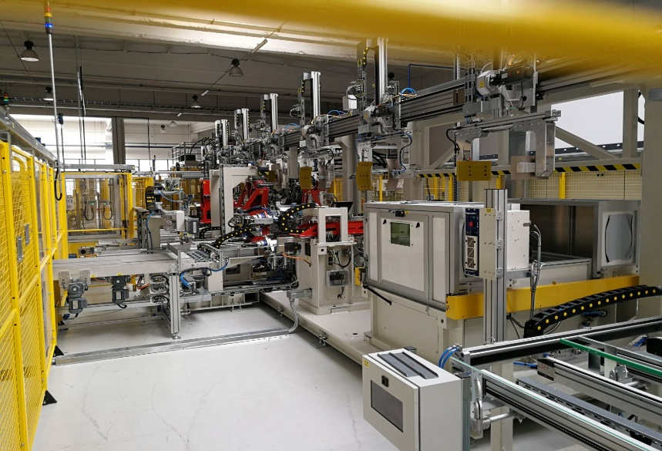
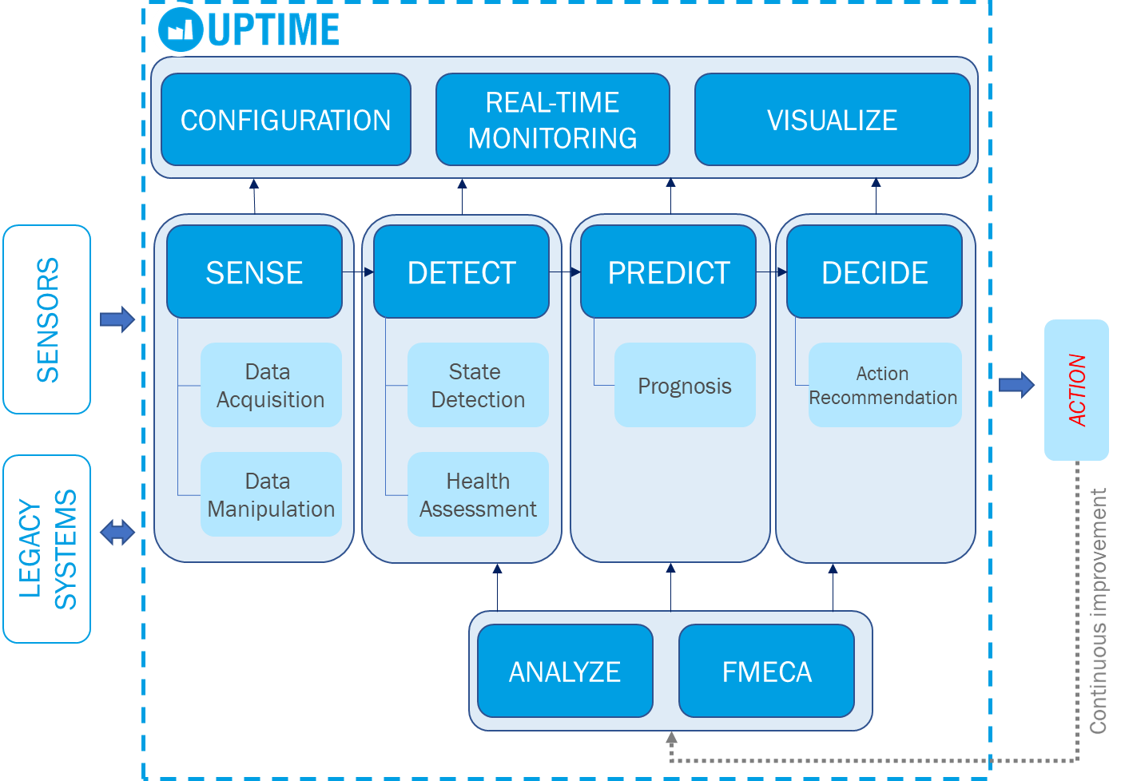
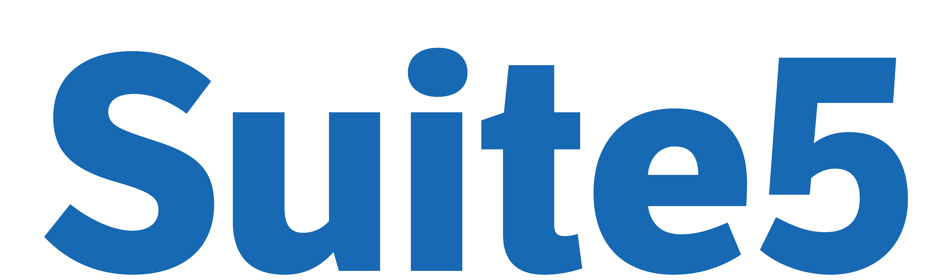
UNIFIED PREDICTIVE MAINTENANCE SYSTEM AND
SEMANTIC WEB STANDARDS
Karl HRIBERNIK (BIBA) – Dimitris NTALAPERAS (UBITECH) – Yves KERARON (ISADEUS)
ABSTRACT
UPTIME & SEMANTIC WEB STANDARDS
Traditional maintenance approaches are under-optimized. 20% savings on total maintenance costs and improvements of Overall Equipment Effectiveness (OEE) are achievable. The UPTIME solution is built upon the predictive maintenance and four integrated technological pillars, Industrial Internet, IoT, Big Data and Proactive Computing.
Semantic Web standards are used for the interoperability of the components of the e-maintenance UPTIME platform and for its extensibility to various industrial domains.
Semantic Web technologies are currently in a transition phase from research to industry where they raise growing interest. UPTIME e-maintenance platform, is composed of interacting components and aim at a seamless plugin with diverse industrial information environments. As such, it needs a standardization approach from the data acquisition, linking to querying for decision.
Semantics and ontologies have been identified as means to tame the issues linked to the diversity of the components of the UPTIME e-maintenance platform and its deployment in various industries.
W3C standards are considered for:
Data exchange using MIMOSA OSA CBM (Open System Architecture Condition Based Maintenance) XML schemas to support the implementation of ISO 13584 - Condition Based Maintenance and Diagnosis
Data Linking and cleansing to bring together data from various sources and create value, to improve their quality and to flexibly integrate new datasets
Ontology based Modeling to represent knowledge and exploit it.
VISION
UPTIME provides next-generation predictive maintenance aiming to optimize in-service efficiency, to self-improve over time and adapt to dynamic manufacturing environments. It proposes a novel predictive maintenance management model along with an associated information system.
Moreover, UPTIME follows a data-driven approach, which makes it applicable to every kind of equipment and industry regardless of their production processes and physical models.
UPTIME unifies operational intelligence and business analytics in the context of Industry 4.0 in order to provide visibility and insights into data and maintenance operations. This unification not only enables observing deviations in the manufacturing processes, but also predicting failures, deciding optimal maintenance plans and acting ahead of time, in a proactive way.
With UPTIME, manufacturing firms are able to harness different technologies, data sources (e.g. sensors, SCADA, PLC, asset management systems) and expert knowledge in order to drive maintenance operations through better decisions.
Generic groups of functions of the UPTIME solution
High Level Business Data Model
UPTIME APPROACH
INDUSTRIAL ISSUES
UPTIME enables manufacturing companies to fully exploit real-time and historical data. It takes assisted decision-making to the next level by presenting maintenance scenarios with the optimal maintenance actions to implement at the optimal time. The operators are then able to mitigate risks, minimize maintenance costs and improve OEE.
Cold Rolling Mill Lines
Wing Upper Cover Transportation Jig
White Goods Production
BENEFITS
A powerful decision-making tool to minimize overall costs
Optimal maintenance actions to mitigate failure risks
Optimal implementation time to optimize production schedule
Maintenance scenario simulation to explore alternatives
Sensor-enabled feedback to constantly improve recommendations
Innovative technologies such as Internet of Things (IoT) or Analytics Capabilities offer opportunities to monitor and predict the condition of assets
However, manufacturers are faced with barriers to reach these opportunities
Difficulties of deployment
Lack of standardization
Lack of suitable competencies
Current predictive maintenance solutions only offer analytics capabilities to predict failures and estimate the remaining lifetime of assets. Operators have to use their own experience to:
Make decisions of what maintenance actions to implement
Balance between multiple variables to decide when to implement them in the planning
UPTIME PARTNER PROGRAM
CONCLUSION
It provides information, use cases analyses and assistance with the implementation of the UPTIME solution with proven benefits based on real industrial use cases. Software technology is provided free of charge.
Join the UPTIME community!
community@uptime-h2020.eu
Further information on the UPTIME Partner Program on our website: www.uptime-h2020.eu
Solutions based on semantic Web Standards are serious alternatives to traditional solutions with low interoperability and high costs of obsolescence.
The UPTIME project is an opportunity to demonstrate for concrete industrial use cases, the benefits of web based standards for the Maintenance of the Future.
This project has received funding from the European Union's Horizon 2020 research and innovation program under grant agreement No. 768634.
Copyright © 2017 - 2020 UPTIME Consortium. All rights reserved.

